Slide 1
Analyzing MLB 2-Pitch Sequences: Does Swinging on the First Pitch Lead to Better Decisions?
Amor Ai
May 3, 2023
Notes:
Good afternoon, I am really excited to share with you both my project on … investigating

Slide 2
Overview of Data
414799 pairs of pitches from the beginning of the 2023 Major League Baseball (MLB) season
Notes:
I was working with a dataset that contains 414,799 pairs of pitches from the beginning of the 2023 Major League Baseball (MLB) season. Each row in the dataset corresponds to 2-pitch sequence (first 2 pitches thrown to a batter), and we have corresponding contextual information about each player’s at-bat.

Slide 3
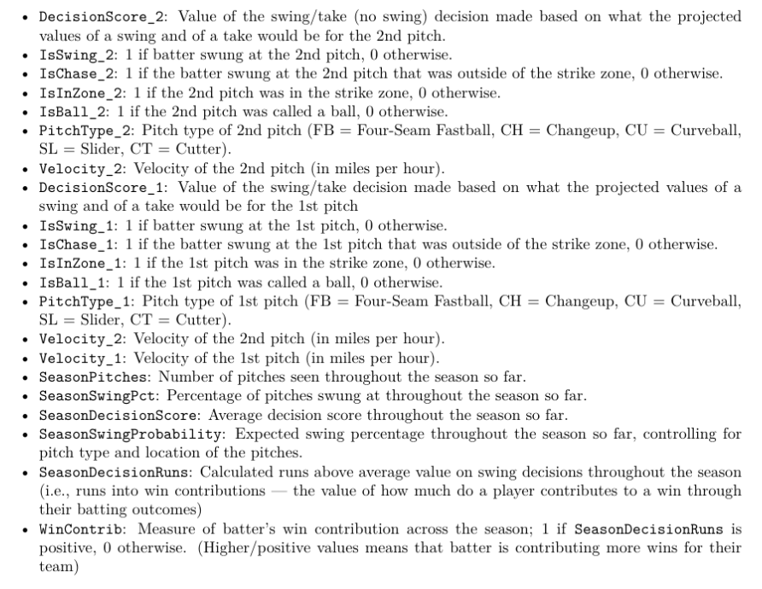
19 variables + 1 additional
Notes:
Here are the descriptions of all the variables in this dataset . I would like to direct your attention to a few variables in particular. First, decisionScore_2…in other words, this is variable quantifies how well the batter’s decision was on the 2nd pitch, either not swinging or swinging at a pitch, where a higher value indicates a better decision was made.
IsSwing_1…this is our treatment variable
variables related to the first pitch
I created an additional variable that dichotomizes seasondecisionruns which basically indicates if the batter if contributing more wins for their team or not

Slide 4
Treatment & Outcome Variables
IsSwing_1
1 if batter swung at the 1st pitch, 0 otherwise
DecisionScore_2
Value of the swing/take (no swing) decision made based on what the projected values of a swing and of a take would be for the 2nd pitch
Notes:
As I previously mentioned, `IsSwing_1` is the treatment variable (which was obviously not randomly assigned), `DecisionScore_2` is the outcome variable, and the other variables I mentioned are covariates.

Slide 5
In a 2-pitch sequence, does swinging on a first pitch lead to better or worse swing decisions on the subsequent pitch?
Notes:
As the title suggested, the overall purpose of this project is to analyze, in a 2-pitch sequence, the effect of the first pitch on the outcome of the second pitch. More specifically, does swinging on a first pitch lead to better or worse swing decisions on the subsequent pitch?

Slide 6
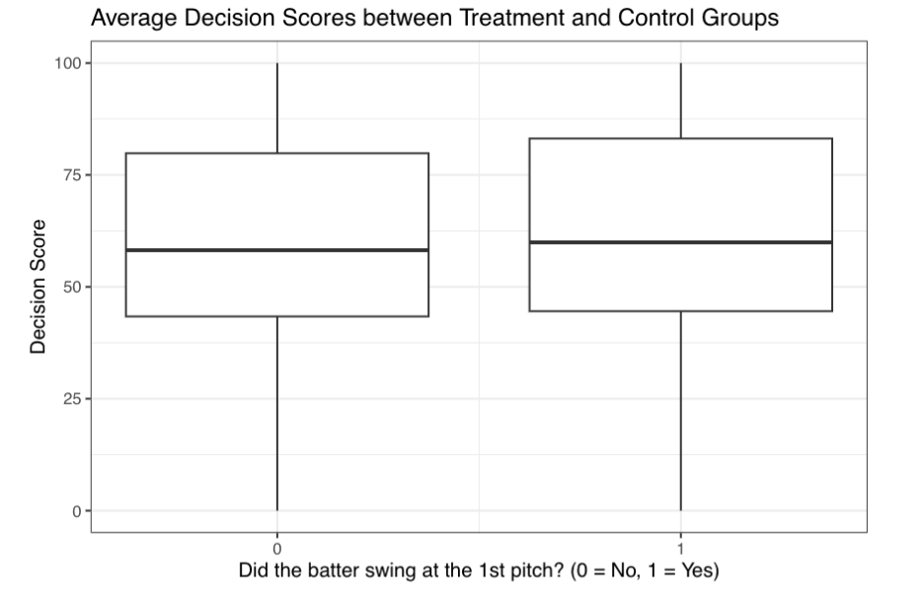
What if this dataset came from a completely randomized experiment? (i.e., if IsSwing_1 was randomly assigned)
Average treatment effect (ATE) = 1.417
Swinging leads to significantly higher decision score!
Unfortunately not…covariate imbalance
Notes:
So what if … well I’d conclude that average treatment effect is 1.417, such that batters who swing at the first pitch have a significantly higher decision score on the following pitch compared to those who don't swing at the first pitch. So we’re done!
this is a naive answer to the causal question, since it doesn't take into account any possible confounders in our data. Since it is certainly reasonable to assume that there may be many factors that are correlated to both the likelihood of swinging and a player's a decision score, this motivates the need to apply various causal inference methods since this is an observational study after all. But before applying these methods, I first checked this assumption of potential confounders using various covariate balance assessments.

Slide 7
Covariate Balance Assessments

Slide 8
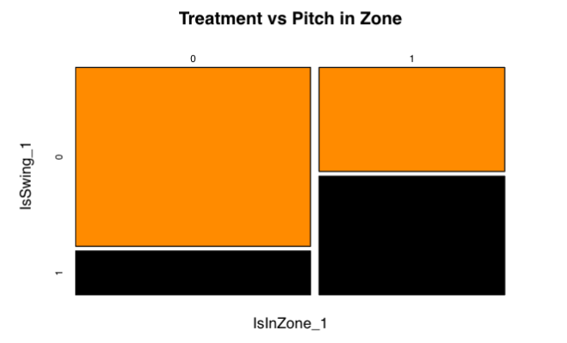
Notes:
From inital EDA of just one variable,IsInZone_1, we observe that there are there are indeed differences indistribution of pitches between treatment and control groups. More specifically, we see that batters are muchless likely to swing at pitches out of the zone (IsInZone_1= 0) and more likely to swing at first pitchesthrown in the zone (IsInZone_1= 1).

Slide 9
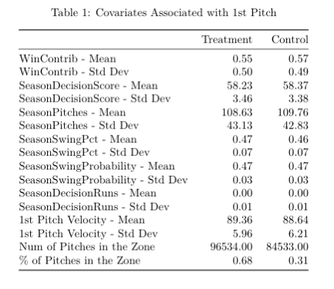
Notes:
Here is the Table 1 of the covariates and we can see that most of the differences between treatment and control seem marginal, except for the last variable here

Slide 10
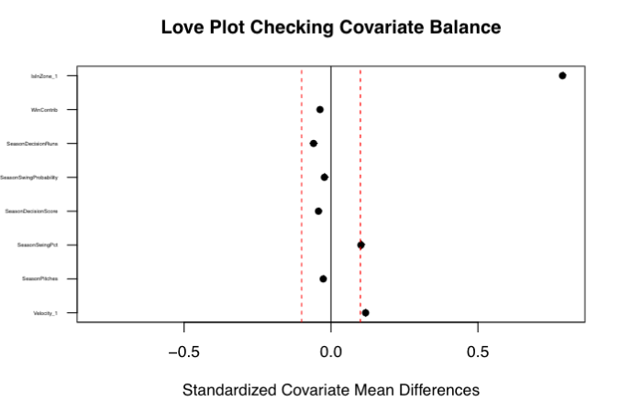
Notes:
According to the Love plot and the 0.1 rule-of-thumb, `IsInZone_1` clearly exhibits concerning covariate imbalance, as the batters in the treatment group were more likely, on average, to see first pitches in the strike zone. Additionally, `SeasonSwingPct` and `Velocity_1` also seems imbalanced , but may not be as concerning
as the batters in the treatment group appear to swing at pitches at a higher rate throughout the season and are receiving slightly higher velocity first pitches than the control group, on average.

Slide 11
Methods: PS Matching, CEM, Cardinality matching, IPW
All using random subset (10%)
41,012 observations, 26,835 controls, 14,177 treated
Notes:
To get the causal effect of swinging at the first pitch, I applied these causal inference methods which I will get into momentarily. Because of the size of the dataset I was working with, in order to implement many of these methods, I focusdc on a random sample of 10% of the data, such that I was working smaller dataset of 41,012 observations.
This dataset has 26,835 control subject and 14,177 treated subjects and will be referenced as the full or original dataset from here on out.

Slide 12
Propensity score (PS) matching
Match each treated subject with a “similar” control subject using nearest-neighbors matching ("greedy algorithm")
1:2 propensity matching
Caliper = 0.1
17,558 control subjects, 13,009 treated subjects
Notes:
Motivated by unconfoundedness, where we are assuming that the treatment is independent of the potential outcomes given the covariates, I first implemented propensity score matching using nearest-neighbors matching ("greedy algorithm"), where at each stage, the algorithm is making the locally optimal choice to minimize the matched distances between treated and control subjects. Since there are almost twice as many control subjects than treated, I matched 2 control subjects to 1 treatment subject — namely 1:2 propensity matching — for computational efficiency. This is an effort to try to obtain an "effectively randomized" matched dataset that exhibits covariate balance.
After implementing 1:2 propensity score matching, I also used calipers as a "tweak" to prevent "bad matches". Setting the caliper to 0.1, this removed any matches that have a larger distance than the indicated cutoff of 0.1, resulting in a slightly smaller matched dataset

Slide 13
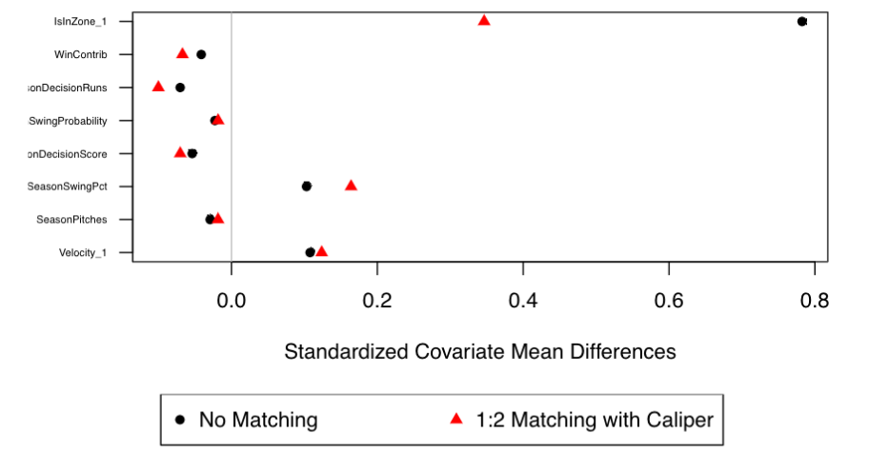
Notes:
This figure illustrates the difference in covariate balance between the dataset before matching and the one after propensity score matching with calipers.
We observe that the matched dataset does not convincingly have better covariate balance because the majority of the standardized covariate mean differences for the matched dataset (red triangles) are very close black circles. Additionally, despite seeing a substantial improvement in covariate balance for the variable `IsInZone_1`, this matched dataset (even after applying calipers) still does not yield overall covariate balance. Thus, this motivates utilizing other techniques that ensure covariate balance, such as

Slide 14
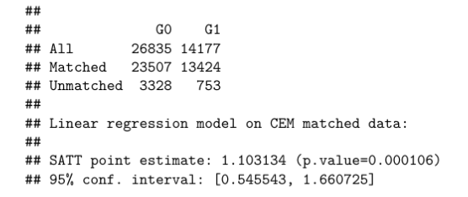
Coarsened Exam Matching (CEM)
Obtain balance directly
Coarsened 8 covariates (Velocity_1, SeasonPitches, SeasonSwingPct, SeasonDecisionScore, SeasonSwingProbability, SeasonDecisionRuns, WinContrib, IsInZone_1) into blocks
Match treatment and control subjects in the same block
Notes:
we optained balance directly from the actual covariates. To implement CEM, I coarsened the 8 covariates of interest into blocks and then matched treatment and control subjects in the same block. After doing so, the causal effect estimation was calculated and the results are shown on the right:
We recall that, in the full dataset, there are roughly 27000 and 14,000 control and treated subjects respectively. Meanwhile, in this CEM dataset, there are only approximately 23000 and 13,000 control and treated subjects. However, the tradeoff of having a slightly smaller sample is that there no need for balance checking since we are exactly matching on the coarsened dataset. In terms of our results from the output, we see that the p-value (0.0001) certainly less than 0.05, so we reject the null hypothesis that the average treatment effect for the treated (MATT) within the matched dataset is equal to 0. The treatment effect is estimated to be 1.103 with a 95% confidence interval between 0.546 and 1.661. Since the confidence interval does not contain 0, this is another indication of a significant treatment effect — but only for the treated subjects in this particular smaller dataset!

Slide 15
Cardinality matching
Finds the largest dataset that satisfies covariate balance constraints
e.g., all standardized covariate mean differences are below 0.1
Error
"The optimization problem may be infeasible. Try increasing the value of 'tols'."
Not feasible!
Notes:
Another automatic optimization method is cardinality matching, where it finds the largest dataset that satisfies covariate balance constraints. Upon applying this method, I encountered an error suggesting: "The optimization problem may be infeasible. Try increasing the value of 'tols'." This means that there was no dataset found to satisfy the tolerance level of 0.01, which was the rule-of-thumb we used as the indication of covariate balance. Since finding a subset does not seem to be feasible using this dataset, I pivoted and attempted to weigh subjects such that they approximate an experiment instead, shown in the following method.

Slide 16
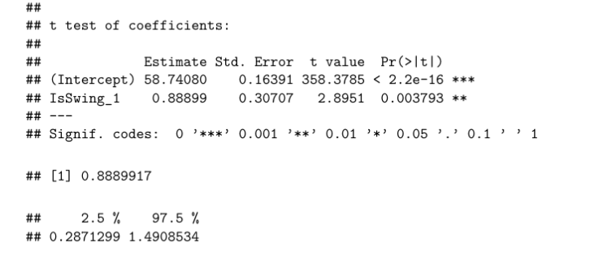
Inverse Propensity Matching (IPW)
Logistic regression —> Propensity score estimates
Extreme weights?
Effective sample size = 30601.44
Ratio = 0.746
Classic IPW estimator point estimate = 0.880
Reduce variance —> “normalized” IPW estimator
Notes:
As a common alternative to matching. First, I used logistic regression to produce propensity score estimates for the dataset, where all of the 8 covariates are used as predictors (with no interactions). After computing the inverse propensity score weights, I considered the possibility of extreme weights that may greatly skew our estimates. So I subsequently checked the effective sample size, which in this case is 30601.44, and the ratio between this effective sample size and the original sample size is 0.746, or about 3/4 of the original sample. In other words, by using IPW here, we are only reducing the sample size by roughly 25%. Now, after plugging the estimated propensity scores into the equation for the classic IPW estimator, we got the following point estimate: 0.880. In an effort to further reduce the variance of our estimator, I then used the “normalized” IPW estimator, and the summary output using this estimator is displayed on the right:
We observe that the point estimate is 0.889, with a 95% confidence interval of [0.287, 1.491]. We see that this confidence interval does not contain 0, and we have a low p-value of 0.004; thus, we reject the null hypothesis that the average treatment effect (ATE) is equal to 0. If the propensity scores were well-estimated, we know that this estimator is indeed unbiased. To ensure that this is in fact the case, I checked covariate balance via weighted standardized covariate mean differences.

Slide 17
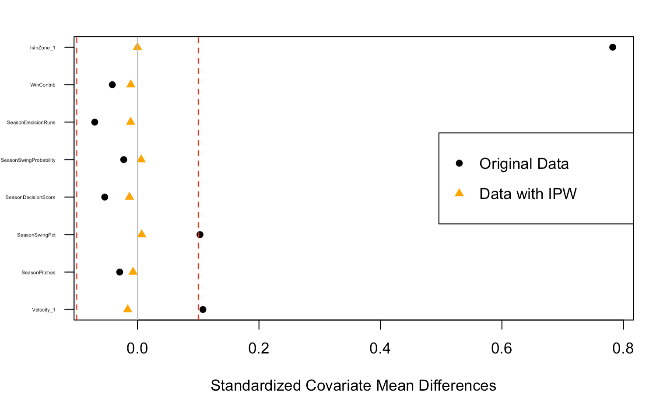
Notes:
From this figure, we see that IPW-based covariate mean differences are centered around zero and all look to be well-balanced. Thus, this suggests that the propensity scores do exhibit the balancing property, which gives some credence to the unbiasedness of our estimator.

Slide 18
Interpretations & Conclusions

Slide 19
Discussion
PS matching: Love plot still exhibited imbalance
CEM: ATT = 1.103
Average treatment effect for the treated in the matched dataset
Cardinality: infeasible
IPW: ATE = 0.889
Average treatment effect is unbiased based on Love plot
—> Only used a random sample of only 10% of the dataset!
Notes:
To recap, I implemented several causal inference methods, some of which were successful and some that were not. I started off with propensity score matching, where I was seeking to find a subset of the data where the treatment approximated an experiment. After implementing nearest neighbors matching, in addition to applying calipers to throw out poor matches, we observed that the Love plot still exhibited imbalance. Since matching is only useful if it produces similar treat and control group (i.e., covariate balance), I could not analyze this data as a matched-pairs experiment and thus were motivated to try a different method instead. Working around the need for balance checking, I then implemented coarsened exact matching, where the covariates of interest were automatically categorized and subjects were exactly matched. The estimated causal effect of swinging at the first pitch was significant for the treated subjects in this CEM dataset, such that swinging at the first pitch leads to higher decision scores of the following pitch on average. On the other hand, we were not able to estimate causal effects using cardinality matching since finding a dataset under the constraint that standardized covariate mean differences were all less than 0.01 was infeasible. Realizing that the treatment effect from utilizing CEM was only for the treated subjects in the smaller matched dataset, I implemented inverse propensity score weighting (IPW) to get at the average treatment effect (ATE) for the full dataset. The estimated ATE came out to be 0.889, which moderately similar to the results from CEM, suggests that swinging at the first pitch leads to higher decision scores on average. This ATE should unbiased if the propensity score model is well-specified, and the Love plot from 2 slides ago gives some credence to this, and thus we can say that this treatment effect targets the full-population ATE; however, it should be noted that in all of these causal inference methods, including IPW, I was only using a random sample of the data, so the lack of generalizability should be considered.

Slide 20
In a 2-pitch sequence, does swinging on a first pitch lead to better or worse swing decisions on the subsequent pitch?
YES!
Notes:
In sum, significant positive treatment effects from our causal inference methods suggest that **swinging on the first pitch DOES lead to better decisions on the following pitch**. Although these results should be taken with reservations (as discussed in the limitations below), players might want to be more intentional about swinging at first pitches — even if you swing and miss, evidence suggests that at least you're more likely to make a better decision on the next pitch!

Slide 21
Limitations & Future Work
Estimating causal effects for a matched sample
Unconfoundedness assumption
Random sample of only 10% of data
Possible next steps could include applying these methods on a larger dataset, and especially one that includes additional player statistics that better contextualizes a players at-bat
Notes:
In this project, we started off by using matching to obtain covariate balance and thus less biasedly estimate the causal effect. However, in doing so, we are estimating the causal effects for a matched sample, instead of the entire population. Additionally, the causal estimate from CEM was only for the treated subjects in the matched dataset, furthering the issue of generalizability especially if there is treatment effect heterogeneity. Nevertheless, estimating the causal effect well for some people is better than estimating poorly for all people. In addition to this, we are also making the Unconfoundedness assumption — that there should be no unobserved confounders that correlate with the potential outcomes and the treatment, after conditioning on the covariates — and thus assuming that matching approximates a randomized experiment. However, Unconfoundedness does not seem plausible given this dataset because many of the key variables in judging the quality of batters are left out (i.e., batting average, on-base percentage, etc.), some of which may definitely be a potential confounder. Future research could investigate this by conducting sensitivity analyses, which places bounds on how much Unconfoundedness can be violated and discovers to what extent can Unconfoundedness be violated without changing our results. As we discussed earlier, one of the main concerns regarding our results was that in order to implement many of these methods, we focused on a random sample of only 10% of the data. Therefore, possible next steps could includeapplying these methods on a larger dataset, and especially one that includes additional player statistics that better contextualizes a players at-bat; doing so would greatly help us unbiasedly estimate the causal effect.

